Slide 1
BAMF
Multi-node Multi-server Home Lab Media Station

Slide 2
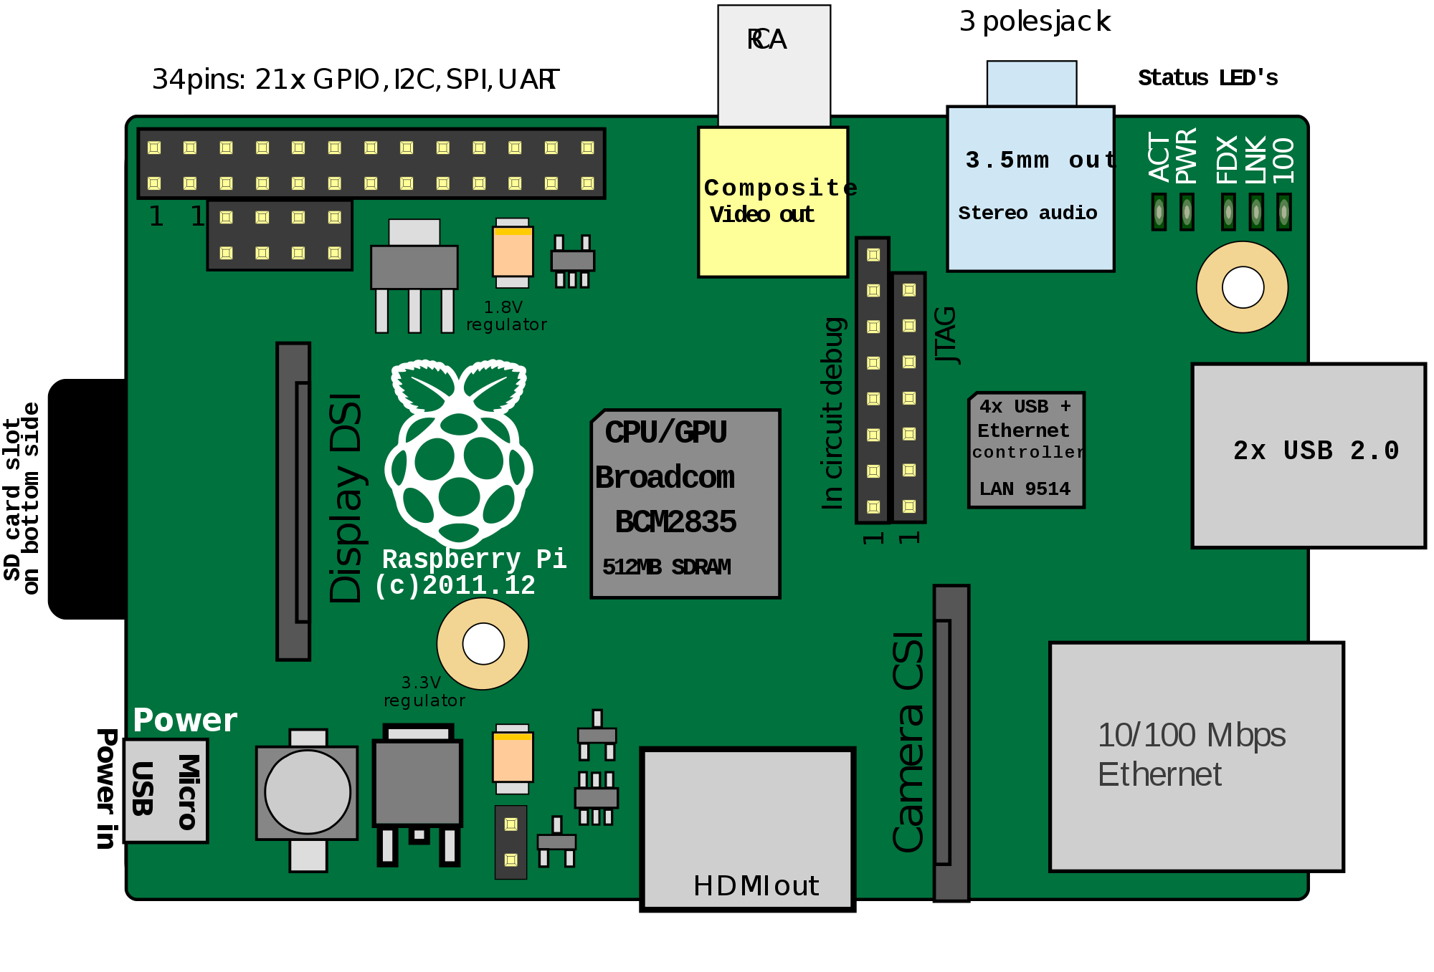
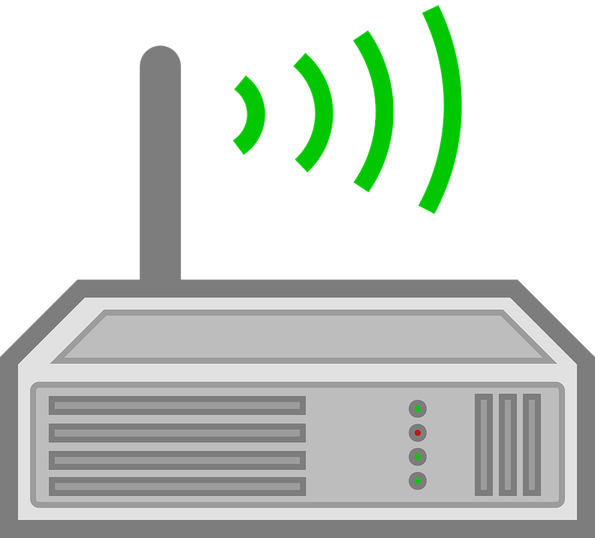


BAMF: Multi-node Multi-server Home Lab Media Station
Home Node Pi
Media Server
Public Node Pi
File Server
Home Lab Server
HDD/SSD
(Storage, Data, Streams)
Hosting Server
Email Server
HDD/SSD
(Files & Media, Dev)
Streaming Server

Slide 3
Server Tech software & programming
Set up OS DietPi
Kubernetes
SSH
VS Code
Python 3 Anaconda
Install NAS file server (SAMBA)
NextCloud
Install Plex, Kodi, Emby
(NVM)Node version Manager, NodeJS and Python, Angular, React, Flask, Ionic, Flutter…all your favorite flavors
PM2 & Forever
Install Droopy
Docker compose system
Nginx proxy manager
Git and Github/bitbucket...
Cloudflare
Reverse DNS NO-IP
NameCheap domains
Adding a SMTP /POP Email Server Postfix & RoundCube

